Slide 1
Title:
Numerical Integration Simulation Using Python
Team Name:
Convergence Crew
Submitted By:
Team Convergence Crew
Al-Fahad:C213001
Mohammad Abrar Yasir:C213002
Md Mokaddess Hossain Adnan:C213007
Mostafa Zamal Zahid: C213035
Submitted To:
Prof.Mohammad Shamsul Alam
Professor
Department of CSE
IIUC

Slide 2
CONTENTS
01
Introduction
05
Simulation
02
Background
06
Future Scope
03
Features
07
Conclusion
04
Theoretical Background

Slide 3
Introduction
Objective: Develop a user-friendly software tool for numerical integration.
Features:
Implements methods like Simpson’s 1/3 Rule, Trapezoidal Rule, and more.
Graphical User Interface (GUI) for ease of use.
Purpose: Enhance learning, accuracy, and computational efficiency.

Slide 4
Background
Definition:
-> Numerical integration is used when symbolic evaluation is not feasible.
Methods Overview:
1. Simpson’s 1/3 Rule
2. Simpson’s 3/8 Rule
3. Trapezoidal Rule
4. Weddle’s Rule

Slide 5
Features
Graphical User Interface:
-> Input for functions, limits, subintervals, etc.
-> Dropdown for integration methods.
Integration Methods:
-> Includes four distinct numerical techniques.
Visualization:
-> Dynamic plotting of function and integration area.
Error Analysis:
-> Absolute error calculation.
Code Modularity:
-> Easy maintenance and extensibility.

Slide 6

Theoretical Background
1. Trapezoidal Rule: The Trapezoidal Rule approximates the area under a curve by dividing it into trapezoids and
summing their areas. It is mathematically represented as:
2. Simpson’s 1/3 Rule: This method uses quadratic polynomials to approximate the function. It is given by:

Slide 7


Theoretical Background
3. Simpson’s 3/8 Rule: This rule utilizes cubic polynomials and requires the number of subintervals to be a multiple of
3:
4. Weddle’s Rule: This is a fixed-coefficient method based on higher-order polynomial interpolation. It uses the
following formula:
It requires a fixed number of subintervals (6).

Slide 8
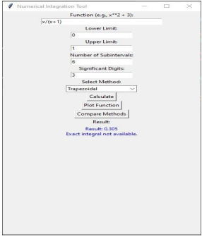
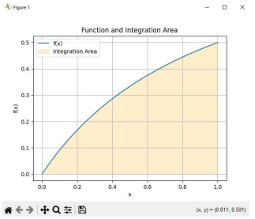
Simulation
Visual representations of results:
Trapezoidal:

Slide 9
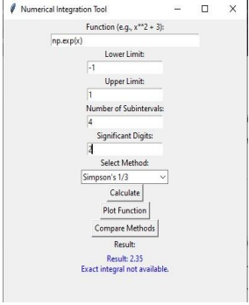
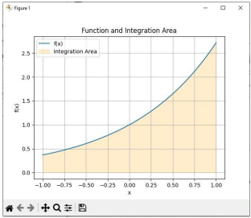
Simulation
Visual representations of results:
Simpson’s 1/3:

Slide 10
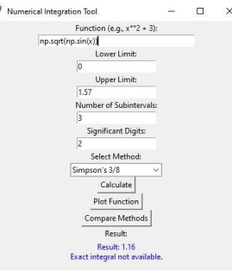
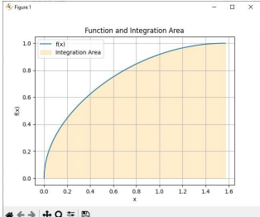
Simulation
Visual representations of results:
Simpson’s 3/8:

Slide 11
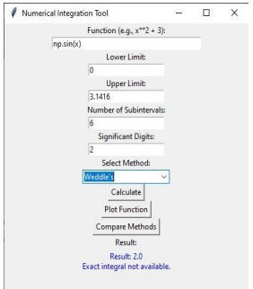
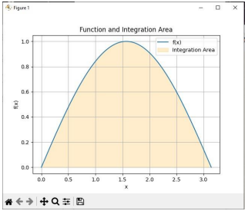
Simulation
Visual representations of results:
Weddle's:

Slide 12
Future Scope
-> Advanced methods (e.g., Gaussian Quadrature).
-> Symbolic integration using SymPy.
-> Adaptive quadrature for better precision.
-> Cloud deployment for broader access.
-> Performance optimization via parallel computing.

Slide 13
Conclusion
-> A versatile tool combining mathematical accuracy and usability.
-> Valuable for academics and professionals alike.
-> Potential for enhancements like error estimation and web integration.

Slide 14
THANK YOU FOR BEING WITH US.

